Slide 1
PROJECT
PROPOSAL
SmartSwipe

Slide 2
TABLE OF CONTENTS
01
04
Our Team
Major Requirements
02
05
About the Project
Project Stages
03
06
Project Goals
Sneak Peek

Slide 3
OUR TEAM
Muhammad Omer (2023-CS-68)
Abubakar Munir (2023-CS-60)
Ahmad bin Rashid (2023-CS-53)
Malik Sohaib (2023-CS-71)

Slide 4
ABOUT THE PROJECT
Welcome to SmartSwipe, where innovation meets convenience in online shopping. Our project is all about creating a user-friendly platform with personalized recommendations and a diverse product range. We prioritize your security with encrypted transactions and offer 24/7 customer support. Join us on this journey to redefine online shopping at SmartSwipe your go-to for a delightful and secure shopping experience

Slide 5
OUR GOALS
Responsive
Dynamic Design
USABILITY
The Website must feel responsive and we will try to integrate the database and website seamlessly.
The Website must have a interesting and Dynamic Design which holds the users attention.
The website must be User - Friendly

Slide 6
MAJOR REQUIREMENTS
User-Side:
Homepage
Sign In and Sign up
Product Page
Cart
Purchase Page
Admin side:
Add Products Page
Customize Layout (Include Side bars, showing or hiding particular part)
Add or remove order managers

Slide 7
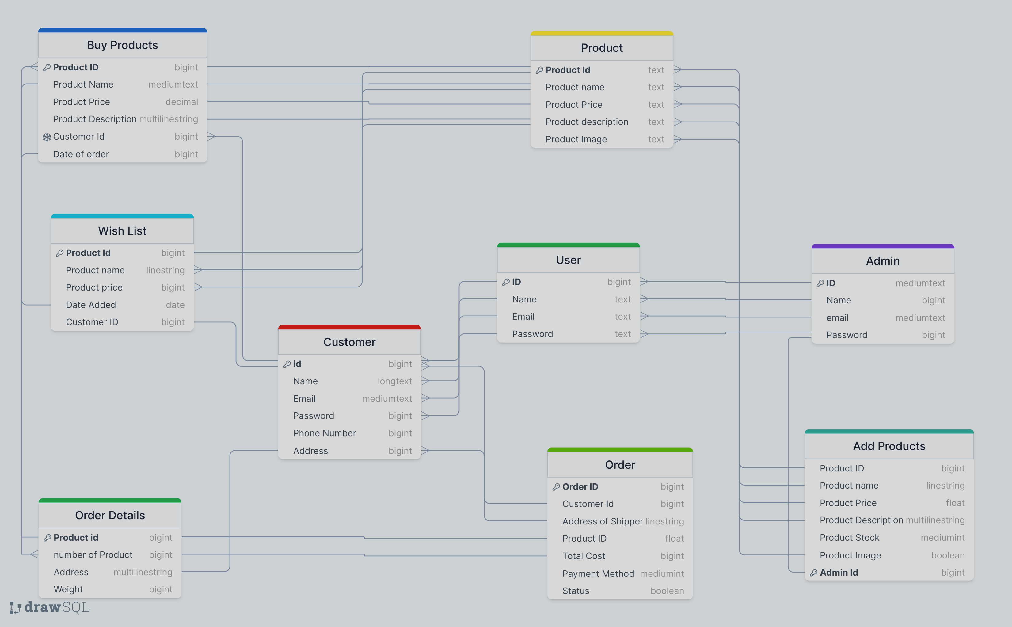

Slide 8
PROJECT STAGES
STEP 1
STEP 2
STEP 3
Create Back-End using NODE.js and python
Create a Front-End using
HTML/Css
JavaScript
BootStrap
Join them Together using PHP

Slide 9
OUR TIMELINE
WEEK 1
WEEK 4
Start of Project
FINAL
VERSION
WEEK 2
WEEK 12
Proposals and ideas
Start working on Back-End
Start working on Front-End
Finish Project

Slide 10
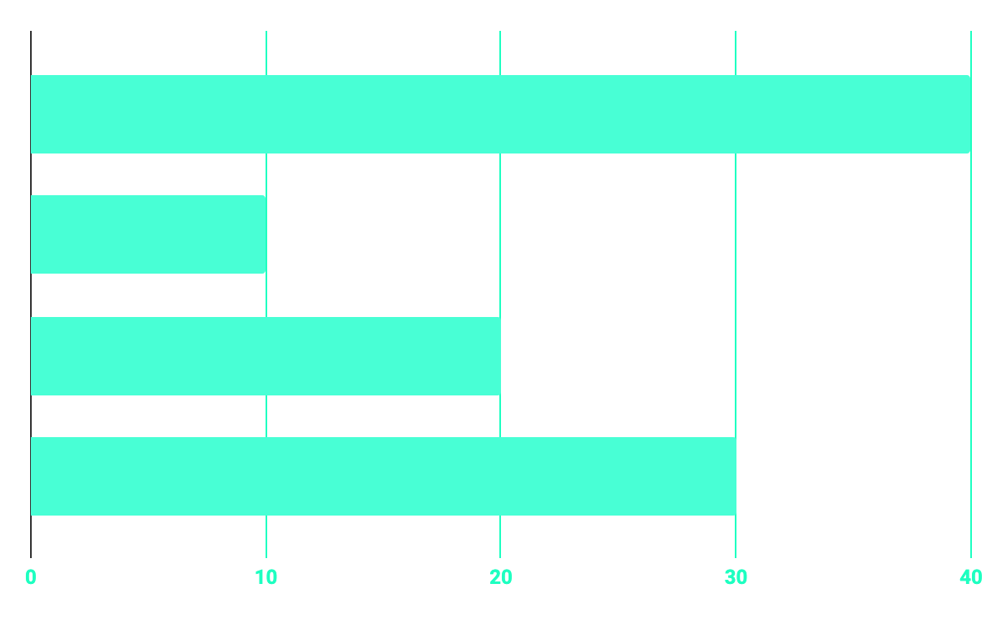
Time management
5%
40%
PROGRAMMING
35%
20%
DATABASE
WEB DESIGN
UX RESEARCH

Slide 11
THANKS!
Does anyone have any question?

